Slide 1
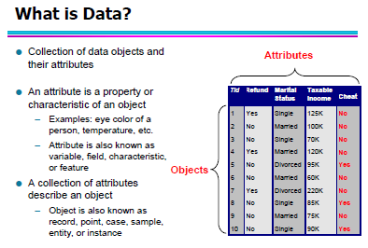
Data Mining: Other Basic Concepts
Information & Media Tech. [IMT] Dept., SICT.

Slide 2
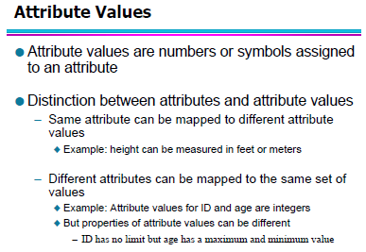
Data Mining: Other Basic Concepts
Information & Media Tech. [IMT] Dept., SICT.

Slide 3
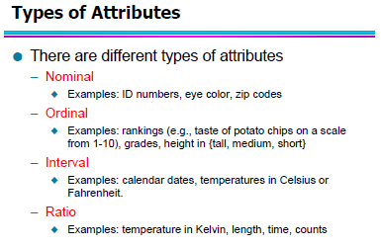
Data Mining: Other Basic Concepts
Information & Media Tech. [IMT] Dept., SICT.

Slide 4
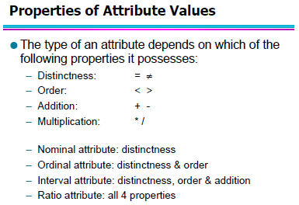
Data Mining: Other Basic Concepts
Information & Media Tech. [IMT] Dept., SICT.

Slide 5
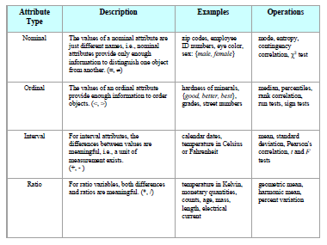
Data Mining: Other Basic Concepts
Information & Media Tech. [IMT] Dept., SICT.

Slide 6
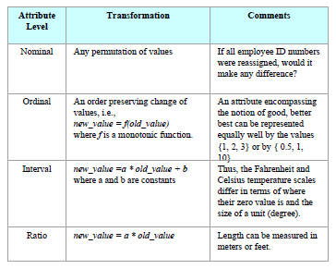
Data Mining: Other Basic Concepts
Information & Media Tech. [IMT] Dept., SICT.

Slide 7
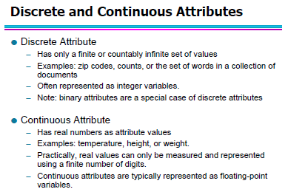
Data Mining: Other Basic Concepts
Information & Media Tech. [IMT] Dept., SICT.

Slide 8
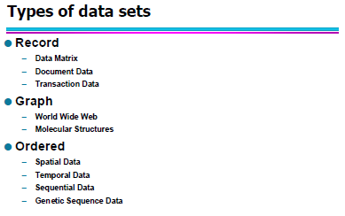
Data Mining: Other Basic Concepts
Information & Media Tech. [IMT] Dept., SICT.

Slide 9
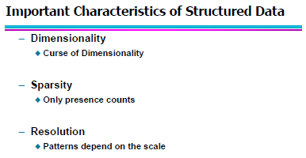
Data Mining: Other Basic Concepts
Information & Media Tech. [IMT] Dept., SICT.

Slide 10
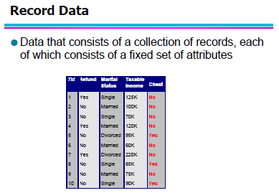
Data Mining: Other Basic Concepts
Information & Media Tech. [IMT] Dept., SICT.

Slide 11
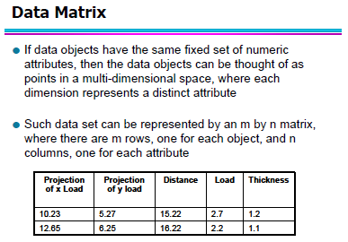
Data Mining: Other Basic Concepts
Information & Media Tech. [IMT] Dept., SICT.

Slide 12
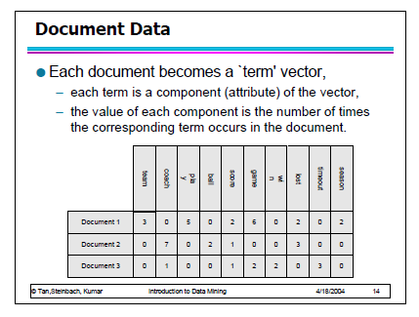
Data Mining: Other Basic Concepts
Information & Media Tech. [IMT] Dept., SICT.

Slide 13
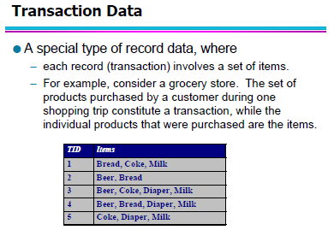
Data Mining: Other Basic Concepts
Information & Media Tech. [IMT] Dept., SICT.

Slide 14
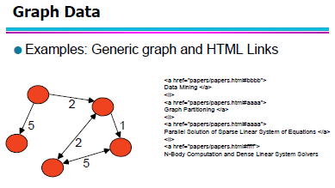
Data Mining: Other Basic Concepts
Information & Media Tech. [IMT] Dept., SICT.

Slide 15
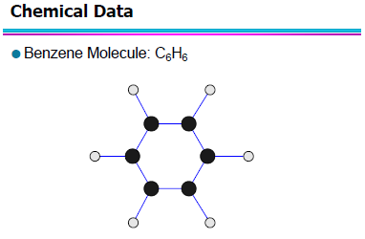
Data Mining: Other Basic Concepts
Information & Media Tech. [IMT] Dept., SICT.

Slide 16
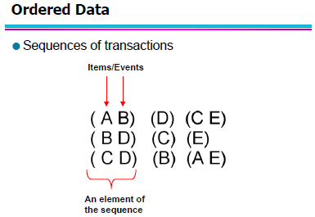
Data Mining: Other Basic Concepts
Information & Media Tech. [IMT] Dept., SICT.

Slide 17
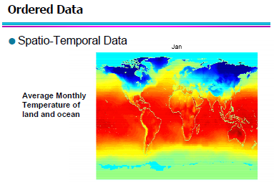
Data Mining: Other Basic Concepts
Information & Media Tech. [IMT] Dept., SICT.

Slide 18
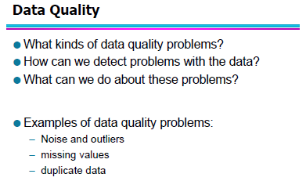
Data Mining: Other Basic Concepts
Information & Media Tech. [IMT] Dept., SICT.

Slide 19
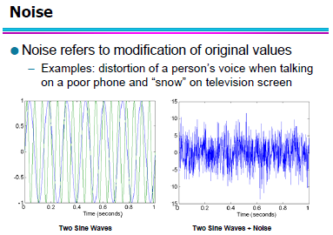
Data Mining: Other Basic Concepts
Information & Media Tech. [IMT] Dept., SICT.

Slide 20
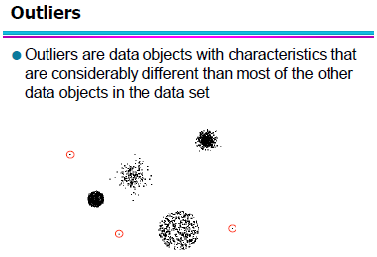
Data Mining: Other Basic Concepts
Information & Media Tech. [IMT] Dept., SICT.

Slide 21
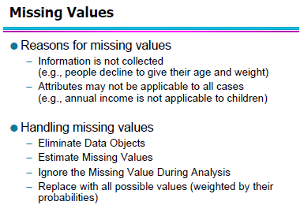
Data Mining: Other Basic Concepts
Information & Media Tech. [IMT] Dept., SICT.

Slide 22
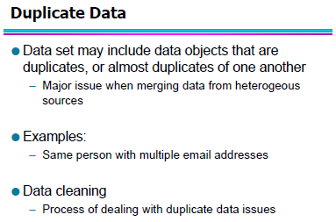
Data Mining: Other Basic Concepts
Information & Media Tech. [IMT] Dept., SICT.

Slide 23
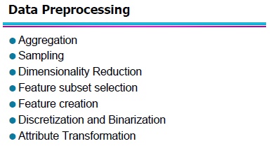
Data Mining: Other Basic Concepts
Information & Media Tech. [IMT] Dept., SICT.

Slide 24
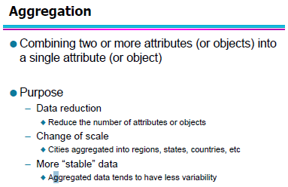
Data Mining: Other Basic Concepts
Information & Media Tech. [IMT] Dept., SICT.

Slide 25
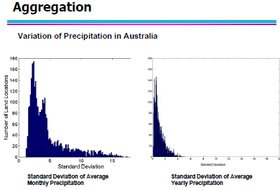
Data Mining: Other Basic Concepts
Information & Media Tech. [IMT] Dept., SICT.

Slide 26
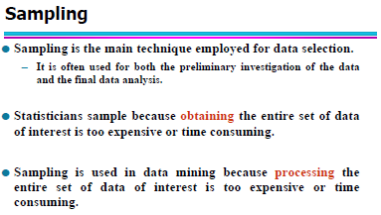
Data Mining: Other Basic Concepts
Information & Media Tech. [IMT] Dept., SICT.

Slide 27
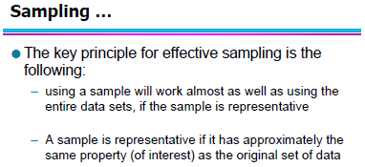
Data Mining: Other Basic Concepts
Information & Media Tech. [IMT] Dept., SICT.

Slide 28
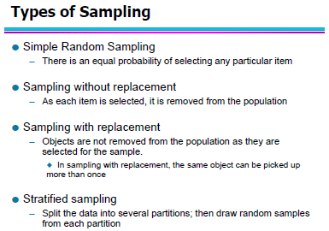
Data Mining: Other Basic Concepts
Information & Media Tech. [IMT] Dept., SICT.

Slide 29
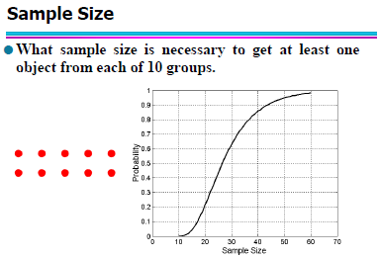
Data Mining: Other Basic Concepts
Information & Media Tech. [IMT] Dept., SICT.

Slide 30
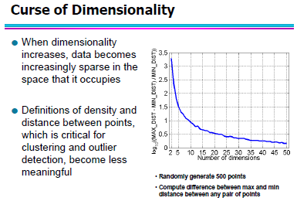
Data Mining: Other Basic Concepts
Information & Media Tech. [IMT] Dept., SICT.

Slide 31
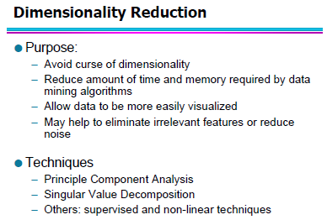
Data Mining: Other Basic Concepts
Information & Media Tech. [IMT] Dept., SICT.

Slide 32
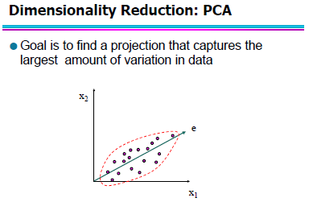
Data Mining: Other Basic Concepts
Information & Media Tech. [IMT] Dept., SICT.

Slide 33
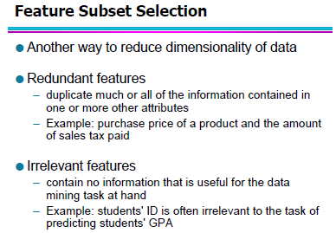
Data Mining: Other Basic Concepts
Information & Media Tech. [IMT] Dept., SICT.

Slide 34
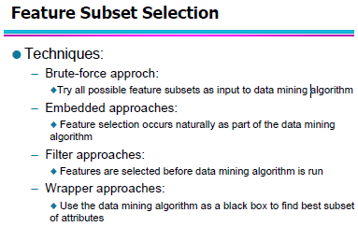
Data Mining: Other Basic Concepts
Information & Media Tech. [IMT] Dept., SICT.

Slide 35
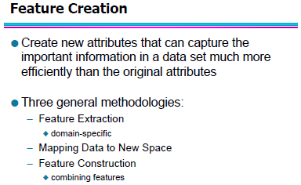
Data Mining: Other Basic Concepts
Information & Media Tech. [IMT] Dept., SICT.

Slide 36
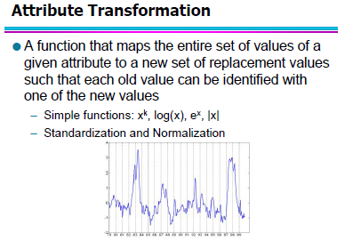
Data Mining: Other Basic Concepts
Information & Media Tech. [IMT] Dept., SICT.

Slide 37
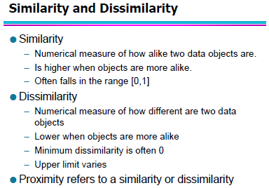
Data Mining: Other Basic Concepts
Information & Media Tech. [IMT] Dept., SICT.

Slide 38
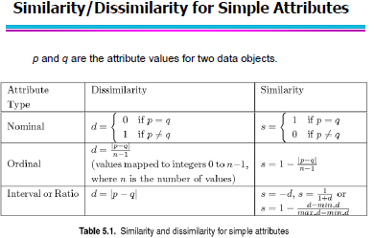
Data Mining: Other Basic Concepts
Information & Media Tech. [IMT] Dept., SICT.

Slide 39
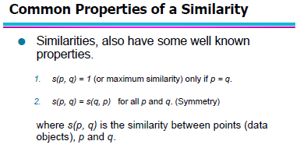
Data Mining: Other Basic Concepts
Information & Media Tech. [IMT] Dept., SICT.

Slide 40
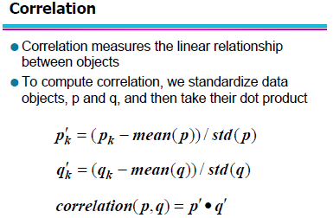
Data Mining: Other Basic Concepts
Information & Media Tech. [IMT] Dept., SICT.

Slide 41
End
1.0 Introduction
End of Module 2
CIT 314: Database Concept & Systems

